Slide 1
Online Shopping Project
itle

Slide 2
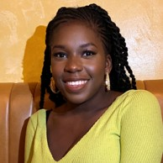

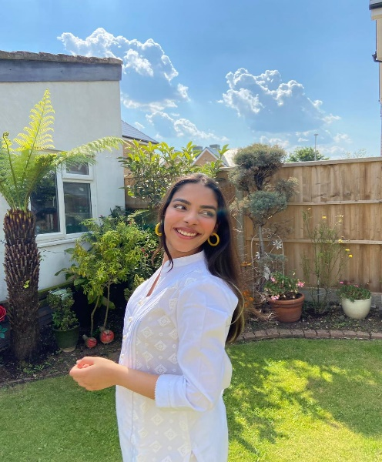
Meet the Team
Nosente Goll
Scrum Master
Front End Developer
Marley Curtis
Back End Developer
Noor Baakza
Front End Developer

Slide 3
Purpose
Notes:
The purpose of our project was to create a online shopping website, where the user is able to create a account and login in order to order the items that they would like.

Slide 4
Two Content Layout with Table
First bullet point here
Second bullet point here
Third bullet point here
Class | Group 1 | Group 2
Class 1 | 82 | 95
Class 2 | 76 | 88
Class 3 | 84 | 90

Slide 5
Title and Content Layout with SmartArt
Step 1 Title
Task description
Task description
Step 2 Title
Task description
Step 3 Title
Task description
Task description
Task description

Slide 6
Add a Slide Title - 1

Slide 7
Add a Slide Title - 2

Slide 8
Add a Slide Title - 3

Slide 10
Add a Slide Title - 4

Slide 11
Add a Slide Title - 5

